Slide 1
Case study municipality

Slide 2
Contents
Introduction
The way
Results
Conclusion

Slide 3
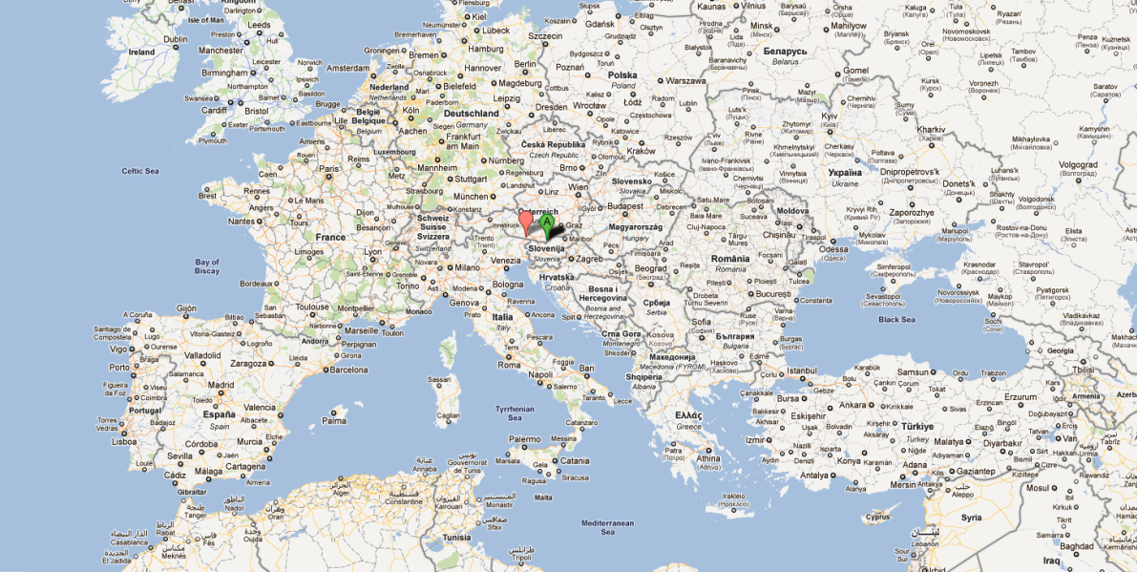
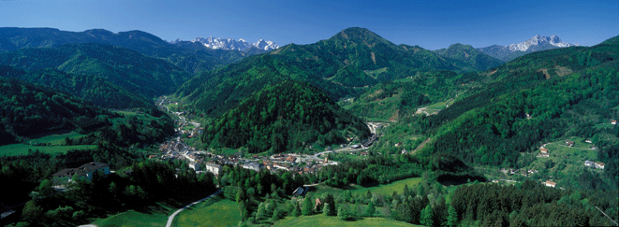
Municipality
Eisenkappel-Vellach
Notes:
Bad Eisenkappel ist Austria‘s most Southern municipality with 2500 inhabitants. It is situated near the Slovenian Border

Slide 4
Challenges and Reasons to implement ISO50001
Up to now no methodology / instruments to focus on energy issues in a structured way in boroughs
Individual political parties follow their own programs and have preferences
Overlapping roles and responsibilities
Low level of awareness
No skilled and trained staff
  Large territory
Notes:
In Austria there exists a simple methology, called E5, during which boroughs identify in a very basic way their energy situation. However, no continuous process can be implemented by this approach.
The big challenge is that in Bad Eisenkappel there are 6 political parties in the district council. All of them have to agree on the implementation of an EnMS as budgets and resources have to be allocated.
In addition there are several departments, schools, a Kindergarten, a sewage water treatment plant and the public street lighting.
The territory of Bad Eisenkappel covers more than 200 km2. Especially during data recording the large territory caused problems as street lighting measurement is time intensive.

Slide 5
Solutions
Common agreement between all political parties
The implementation process was guided by the chief officer
Initial constitution of the E-Team (chief officer, procurement, construction, building yard, roadmen, sewage works operator, schoolmaster)
Training on technical issues
System boundaries cover not only public buildings & plants but also private premises
Notes:
Die treibende Kraft war Amtsleiter

Slide 6
Contents of an EMS
ENERGY
TEAM
STAFF &
STAKEHOLDERS
ENERGY
POLICY
SIGNIFICANT
CONSUMERS
ENERGY
PROGRAM
DOKU
TRAINING
AWARENESS R.
INFORMATION
Internal AUDIT
REVIEW
PROCUREMENT
MAINTENANCE
External AUDIT
PR

Slide 7
Staff & Stakeholder participation
Staff with direct influence on energy consumption including
Roadmen (street lights and vehicle fleet)
Staff at sewage plant
School director
Head of the Kindergarten
Head of public swimming pool
but also
Cleaning staff
Local media

Slide 8
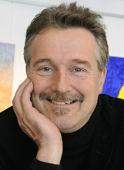
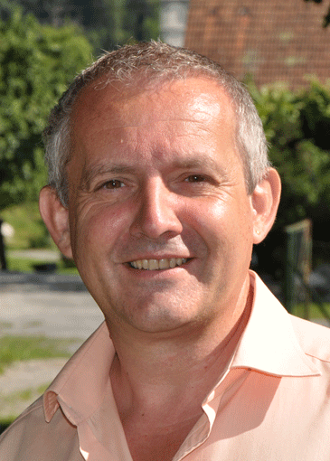
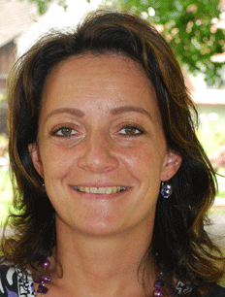
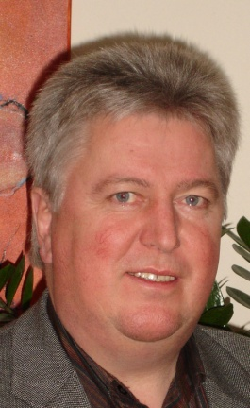

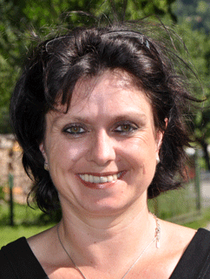
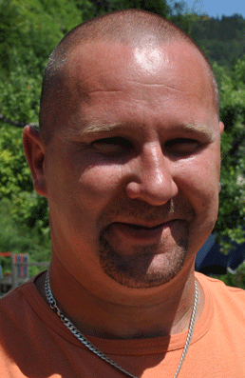
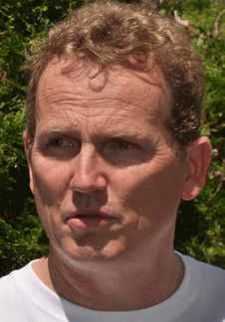
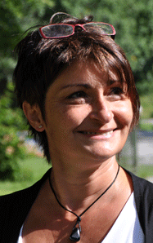
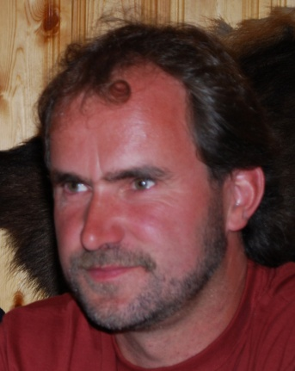
Energy Team
Mayor
E-Manager
Housing
Utilities
Utilities
Procurement
Streets
Schools
Admim
Water/Wastewater
Notes:
It is important to get the participants from all departments and to motivate them to participate in all activities. As Energy Efficiency is known as topic, but no information is available what that means in terms of day-to-day activities, initial training on the individual areas of an EnMS are necessary. In addition, staff needs to get clear commitment from their political decision makers to spend time on this issue.

Slide 9
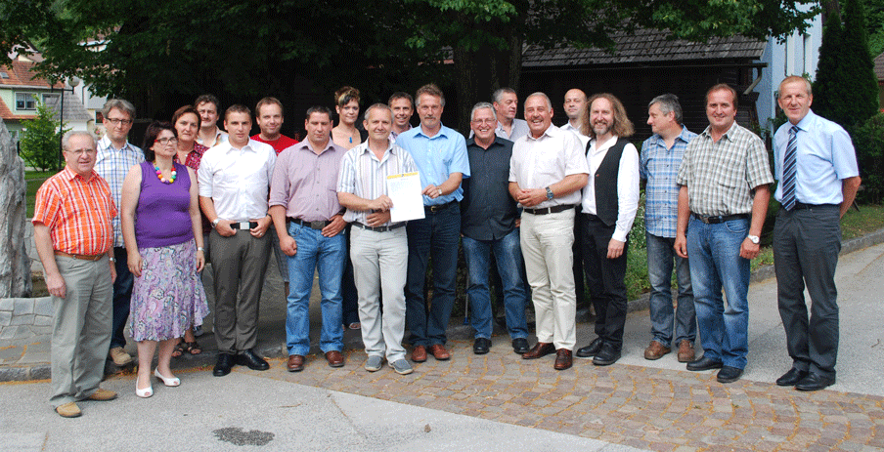
Energy Team –
Political representatives
5 political parties
Notes:
In Bad Eisenkappel there are 6 political parties and it was essential to receive full support from all of them. They are the decision makers and, even more important, it is their duty to make budget available for necessary improvements.

Slide 10
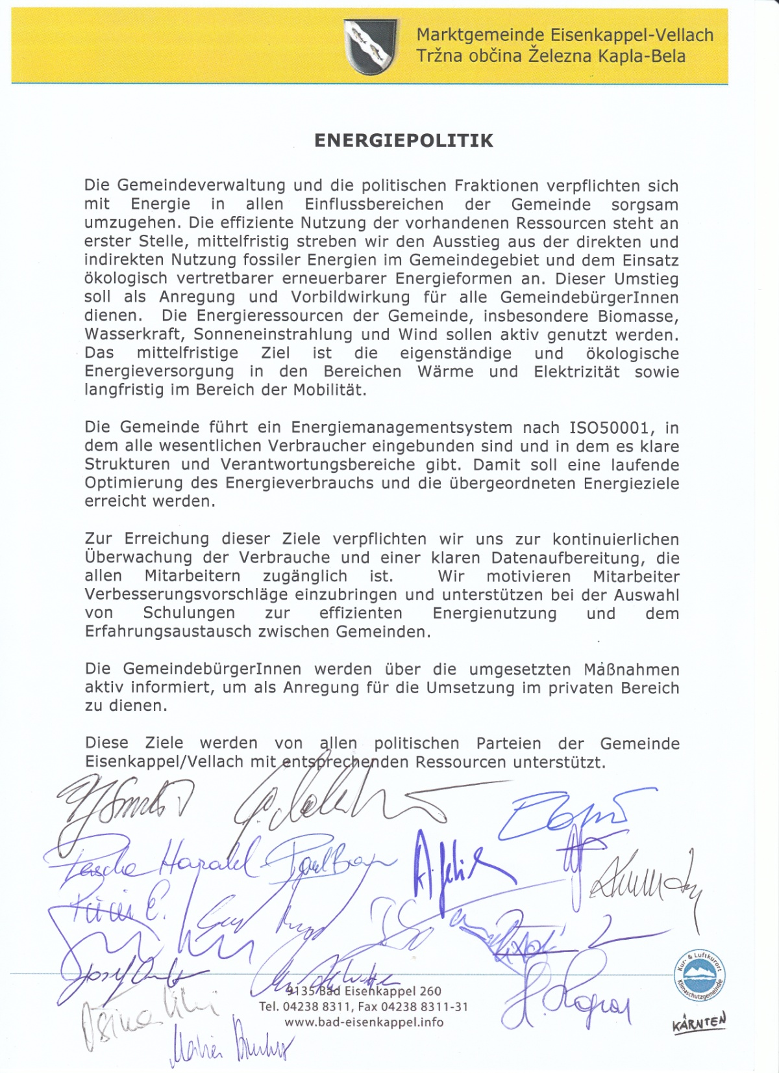
Energy Policy
Discussion with political decision makers
Discussion with E-Team
Long term goals and vision
Budget, resources, training
Let them sign

Slide 11
Identify and measure
energy consumption
Overview on all measurements already installed and which areas are covered (main entrance)
Allocate roles and responsibilities to record data
Temporary measurements for plants, where no continuous measurements are installed (street lights, waste sewage, ventilation)
Data on Intranet available including alert
Notes:
After the overview which measurements are already available the team verified which areas are covered. System boundaries were not clear. So we realised that the heat measurement for the official building also included the Kindergarten, measurements for sewage plant also included pumps for fresh water, some measurements had to be identified (fresh water for primary school). This list was used to document energy consumption on a monthly basis.
The future energy consumption was defined on the basis of past consumptions. In a next step the consumption range was defined so that unusual consumption can be identified immediately.

Slide 12
Significant consumers
First approach: Measure 80% of energy consuming devices
Final solution: All consumers were considered as significant (265 MWh electricity, 455 MWh heat, 790m³ water)
Even more important to identify small, unknown consumers
Continuous monitoring on premises where Energy Manager has direct influence on consumption

Slide 13
Drivers
Consumer | Driver | Level of influence
Street lights | Sun, Weather condition | low
Heating | Outdoor temperature | medium
Sewage plant | Water quantitiy | low
Office equipment | Occupancy | medium
Notes:
Street lights can‘t be influenced as they depend on daily sunshine. – dirty daylight sensors
Heating – only be insulation and heating of areas with occupancy
Water quantitiy – weather and population

Slide 14
Energy program
Areas of improvement developed during initial review
Technical measures to improve energy efficiency
Installation of renewable energy technologies
Objective | Target | Budget | Savings / pay back | Time line | Respons.
Decreasing energy consumption for street light | Installation of LED, movement sensors for pedestrian pathways | €99,000 (€66,000 grant) | €8,000 / yr 4 years | October 2011 | F. Bevc
Decreasing water consumption in primary school | Installation of flow restrictors | €200 | 30% | effected | H. Nečemer
Electricity generation in municipality office | Construction of a photovoltaic plant with 2.8kW | €23,600 (€ 8,600 grant)-including charging station € 9,600 | 10.7 years | effected | F. Bevc

Slide 15
Documentation
One page overview on relevant documents and storage location
Description of key elements (following ISO structure) to achieve common understanding
Existing descriptions to be used and updated (job description, purchase directive)
New installed document storage system used for ISO50001 documents

Slide 16
Documentation
Chapter | Content | Description | Document
1. | Energy policy
 |  | Staff has a common understanding about goals and to do‘s in an EnMS | 3.1 Work place description
 |  | Process instruction to develop and update energy policy | 1.2 PI energy policy
 |  | Develop and update energy policy | 1.1 energy policy
2.1 | Initial review and | Process instruction to collect and measure data | 2.1.1 PI review
 | relevant areas | Measuring significant energy consumers | 2.1.2 relevant energy consumers
 |  | Plan of energy consumers in sewage plant | 2.1.3 Sewage plant Bad Eisenkappel
 |  | Overview of measurements installed | 2.1.4 list of measurements.xls
 |  | Energy consumption of the municipality Bad Eisenkappel | 2.1.5 energy consumption-municipality-2011.xls
 |  | Driver for energy consumption of significant energy consumers | 2.1.6 Driver Bad Eisenkappel.xls
 |  | Template to insert measurements | 2.1.7 meter readings.xls
Notes:
PI process instruction

Slide 17
Training and awareness raising
No training available on energy efficiency topics!
Awareness raising covers staff and inhabitants of Bad Eisenkappel
  Future days
  Survey about habits in private households
  Information about activities of the municipality – do good and tell everybody
Notes:
Training organisations for staff working in the public sector do not offer any training on energy efficiency issues. Only training for sewage plants operators. Plant manufacturers offer training on correct plant operation. Workshops organised by private training organisations are too expensive for public sector.
Awareness raising: Future days – Public discussion forum on goals and actions for a sustainable, energy efficient future
Survey – unemployed people were engaged to personally contact every individual household with a questionnaire on their energy consumption, fuels type, house category, … The results showed that only 20% of private households heat their premises with oil, 80% with biomass or district heating (coming from biomass). However, 80% of the private houses are not proper insulated.

Slide 18
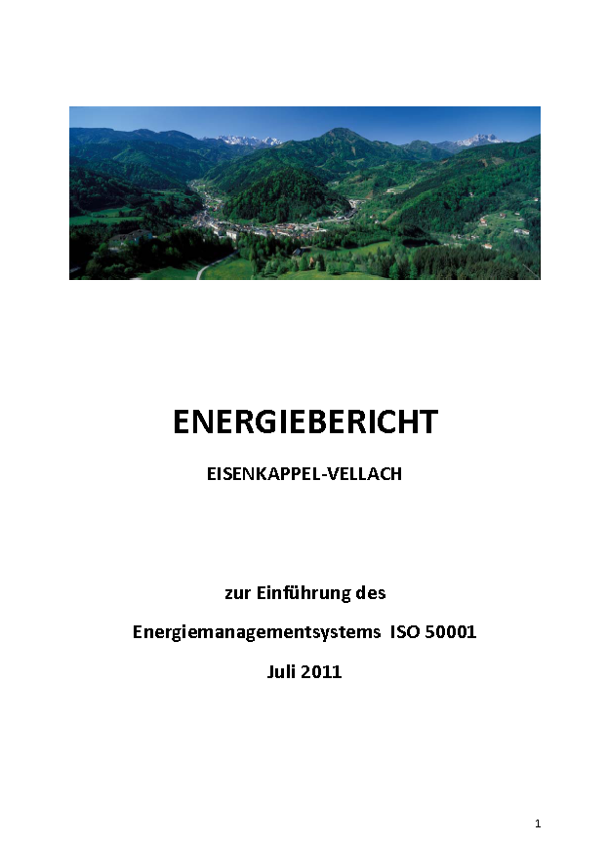
Information
Information provided during regular face to face meetings
Ad hoc meetings only in case of unusual consumption patterns
Energy report compiled once per year
The Energy Management Manual published on the homepage of the municipality

Slide 19
Internal Audit
Internal Audit carried out by the head of the primary school
Goal was to identify gaps between theory and practice, if all process descriptions, documents, measurements and communication channels are in line with the En-Manual

Slide 20
Review
Results were presented to the municipal council

Slide 21
Procurement
There are already public procurement directives in place but nobody follows
Guideline for purchase of Energy Efficient devices were developed
Job description updated to have clear competencies

Slide 22
Maintenance
No clear maintenance procedures in place
Equipment list was developed including competencies
Clear rules for maintenance intervals

Slide 23
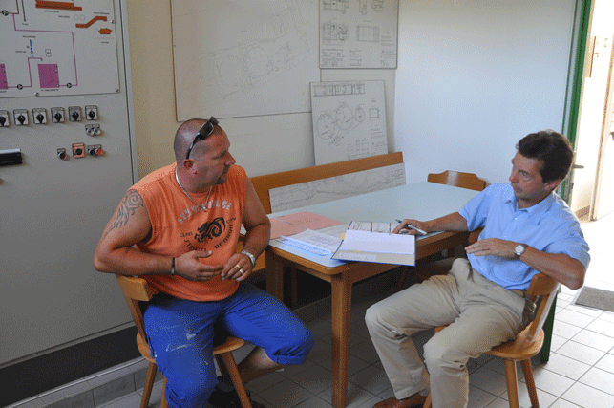
External Audit
Audit by TUEV-SUED carried out in June 2011
All areas audited by an independent, external auditor
Main focus on practicability

Slide 24
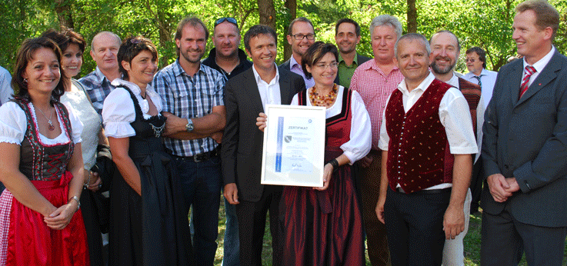
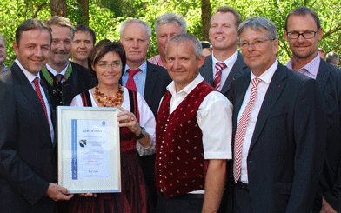
Public Relation
Public organisations need to show and present their activities
Press release
Press conference
Articles

Slide 25
Results
1st year:
  Total Heat Costs 2010 ~ € 27,405
  Total Electricity Costs 2010 ~ € 53,000
  Electricity Reductions ~ 25 %

Slide 26
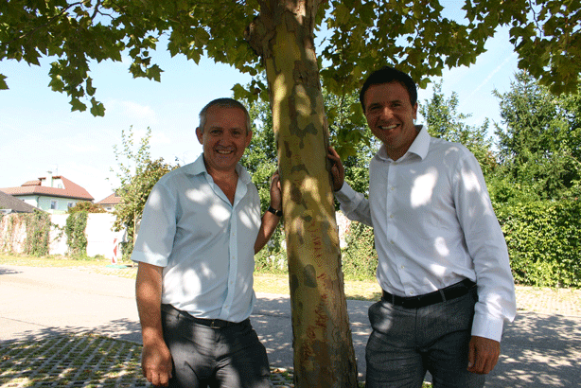
Conclusion
Support of all political parties necessary
Staff of different departments must participate
Relevant energy consumers must be measured
Keep administration to a minimum
Continuous, structured meetings
If possible include municipality territory

Slide 27
Thank you for your attention!

